Slide 1
Smart Grid Vulnerability Analysis Methods
Nyffeler, Lehman, Ward

Slide 2

Consider, if you Will…
Power interruptions can cripple…
Payment processors
Students submitting homework at the last minute
Sewage pumps
Medical equipment
Significant portions of infrastructure for extended periods
Cellular networks (911 calls)

Slide 3

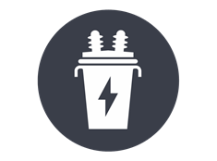
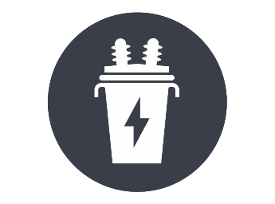



Definitions
A smart grid is a computerized power grid.
In the event of a malfunctioning unit (generator or transformer), power can be automatically redirected from elsewhere.
Transformer
Generator
Consumer

Slide 4

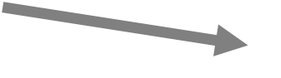
Definitions
A smart grid is a computerized power grid.
In the event of a malfunctioning unit (generator or transformer), power can be automatically redirected from elsewhere.
Transformer
Generator
Consumer

Slide 7
Background Information
Smart grids can be vulnerable to attacks.
If key points are forced offline, the failures can “cascade.”
Cascade happens when the remaining infrastructure fails to meet the burden being placed on it and components begin to fail.

Slide 8

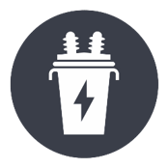


Cascade: an Example
Observe how the marked transformer fails in this scenario:
Transformer
8
Max
Load 1
3
1
Generator
Total
1
1

Slide 9
Cascade: an Example
A failure elsewhere cause power to be redirected to the transformer
Transformer
8
Max
Load 1
+ 1
3
1
Generator
Total
1
1

Slide 10
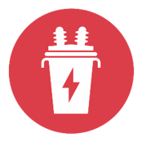
Cascade: an Example
The redirection overloads the transformer
Transformer
8
Max
Load 1
+ 1
2
3
1
Generator
Total
1
1

Slide 11
Cascade: an Example
The overloaded transformer fails, causing a domino effect that cascades
Transformer
8
Max
3
1
Generator
Total
1
1

Slide 12


Cascade: an Example
Observe how the marked transformer fails in this scenario:
8
3
1
Load 1
Transformer
Max
1
1
Generator
Total

Slide 13
Cascade: an Example
Observe how the marked transformer fails in this scenario:
8
3
1
Load 1
+ 1
Transformer
Max
1
1
Generator
Total

Slide 14

Cascade: an Example
Observe how the marked transformer fails in this scenario:
8
3
1
Load 1
+ 1
2
Transformer
Max
1
1
Generator
Total

Slide 15
Cascade: an Example
The initial failure causes a domino effect (cascade).
8
3
1
Transformer
Max
2
2
Generator
Total

Slide 16
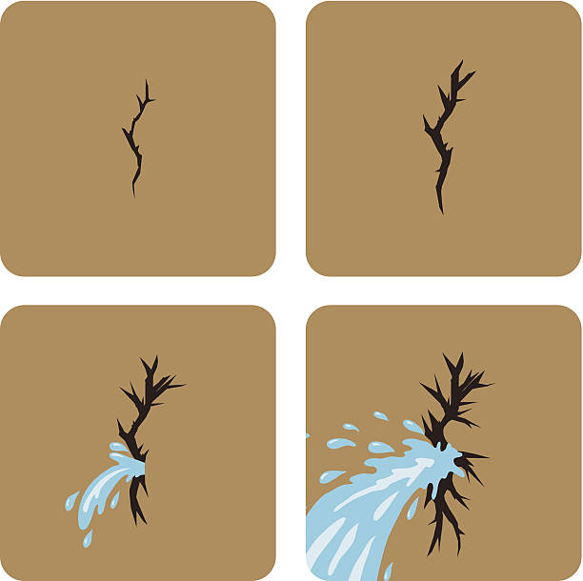
Research Question
How can we determine the cascading failure point of a system?

Slide 17
Research Problem
What is our problem?
We need to find out what the most vulnerable points in the grid are, so that we can protect it from potential attacks.

Slide 18


What Can We Do?
Think like the attacker.

Slide 19

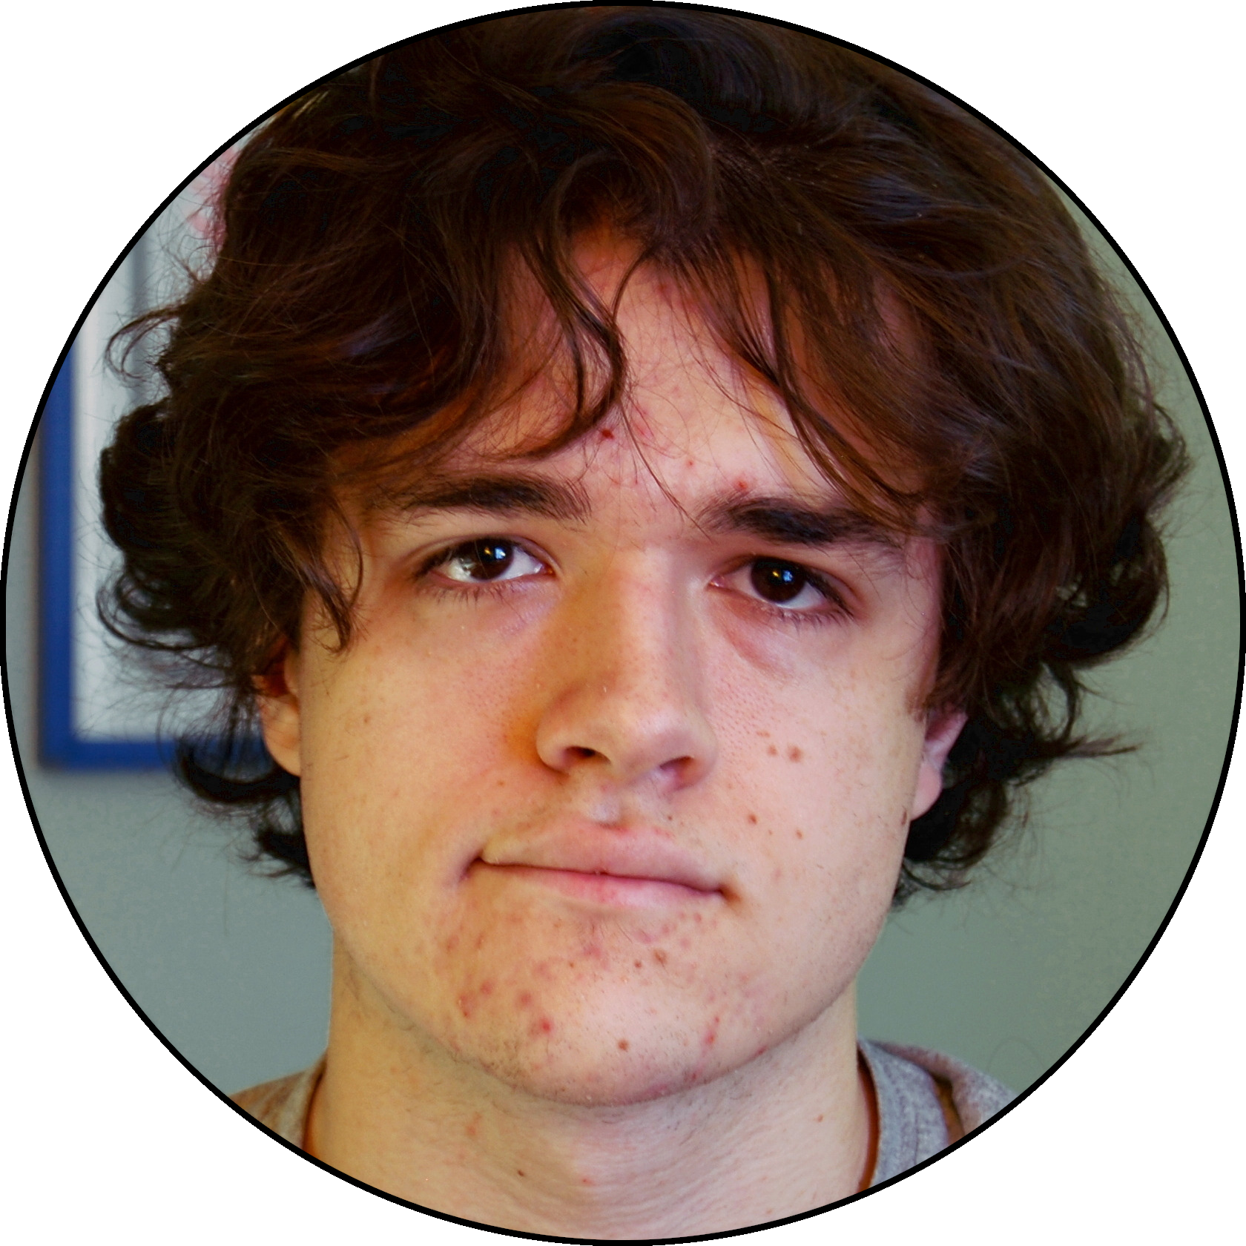
Thinking Like an Attacker
Attackers have finite time/money.
Their attacks need to count.
University
Hospital
Individual
Notes:
Minnow and whale for importance? (use animation/pictures)

Slide 20
Priorities
The hospital and university are more attractive targets, and a better use of money and time.
University
Hospital
Individual
Notes:
Minnow and whale for importance? (use animation/pictures)

Slide 21
Priorities
If there’s still time and money left over, then moving to a lesser target is still OK, though.
University
Hospital
Individual
Notes:
Minnow and whale for importance? (use animation/pictures)

Slide 22
What Can We Do?
Everything they do has a cost
Systems that can harden locations from attacks frequently have large costs
Thus, not every location will have the same level of protection
Some may have no protection at all
The level of protection afforded to a location is frequently proportional to the attractiveness of disabling that location

Slide 23


What Can We Do?
Not all attack points are as “valuable”
For example, individual houses are not as important as hospitals.
Supports one family
Supports entire communities
Notes:
Minnow and whale for importance? (use animation/pictures)

Slide 24
System Model: What’s Important?
With how attackers think in mind, a system model was developed.
How can our system be simplified while staying applicable to the real world?

Slide 25
Simplifications
Consumer demand in an area is implied by how much power passes through a transformer.
2
Consumer
Transformer
Town Hall
Notes:
These slides need revisited/removed

Slide 26
Simplifications
Consumer demand in an area is implied by how much power passes through a transformer.
2
Consumer
2
Transformer
Notes:
These slides need revisited/removed

Slide 27
Simplifications
Consumer demand in an area is implied by how much power passes through a transformer.
2
Consumer
5
+
Transformer
3
Notes:
These slides need revisited/removed

Slide 28


Factors
What aspects of the Smart Grid system should we worry about?

Slide 29

Weight
Not all attack points are as “valuable”
For example, individual houses are not as important as hospitals.
Supports one family
Supports entire communities
Notes:
Minnow and whale for importance? (use animation/pictures)

Slide 30

Weight
Individual people might not matter as much as a gas utility company, university, or hospital.
We had to find an objective way to identify structural importance.

Slide 31

Capacity
There is a limit to the amount of electricity that a transformer can handle.
Parts can only be made to work so hard before they fail.

Slide 32

Cost
Attacking a transformer requires spending resources
Attackers have a finite resource budget to work with

Slide 33

System Model
Our system consists of Suppliers, Transformers, and power lines.
Transformers:
Weight (W)
Capacity:
Cost (C)
Notes:
Weight: value of customer,
MAIN IDEA: Minimize resources while maximizing cost

Slide 34
Image Sources
https://www.kissclipart.com/factory-clipart-car-citron-factory-vvucrf/
https://www.wboi.org/post/pfw-reveals-new-athletic-logo
http://www.clker.com/clipart-weight.html
https://fineartamerica.com/featured/1-water-overflowing-cup-zing-images.html
https://pixabay.com/vectors/cash-finance-financial-green-ideas-1296584/
https://veritasdomain.wordpress.com/2016/02/07/why-write-a-post-addressing-the-issue-of-sins-as-reasons-why-people-leave-church/
https://clipartix.com/questions-clipart/
http://www.clker.com/clipart-orange-house-2.html
http://cliparts.co/pictures-of-a-hospital
https://picsart.com/hashtag/hacker/popular-stickers
https://mywordsateme.blogspot.com/2012/01/blurb-about-blurbs.html
https://www.istockphoto.com/jp/%E3%82%A4%E3%83%A9%E3%82%B9%E3%83%88/%E6%BC%8F%E3%82%8C%E3%82%8B?mediatype=illustration&phrase=%E6%BC%8F%E3%82%8C%E3%82%8B&sort=mostpopular

